Slide 1

Zooming through Zephaniah
How to read the Prophets

Slide 2
Reading the prophets
What has been your experience of reading the prophets?

Slide 3
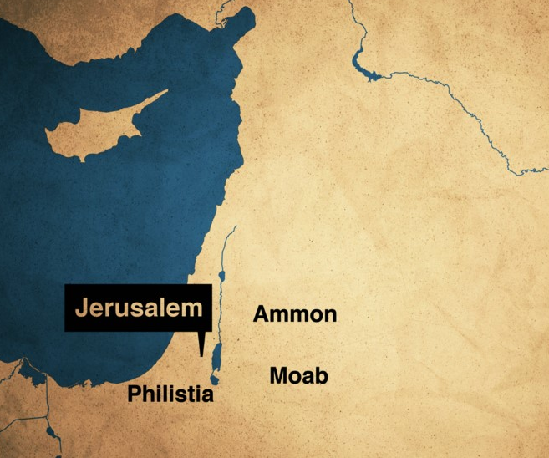
The prophets are historical spokespersons
Primary function: speaking for God to their contemporaries
Historical distance: we need to get a handle on the religious, cultural and historical life of ancient Israel
Form: think oracles, not just sentences

Slide 4

Homework review
Try to suggest how you would divide the book up into a few different sections (somewhere between 3-6 sections)
Try to articulate a tweet-sized summary of the book - what is Zephaniah about?
Write down any questions you have about the book as you read through it.

Slide 5
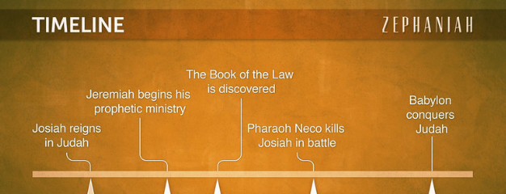
When did Zephaniah prophesy?

Slide 6
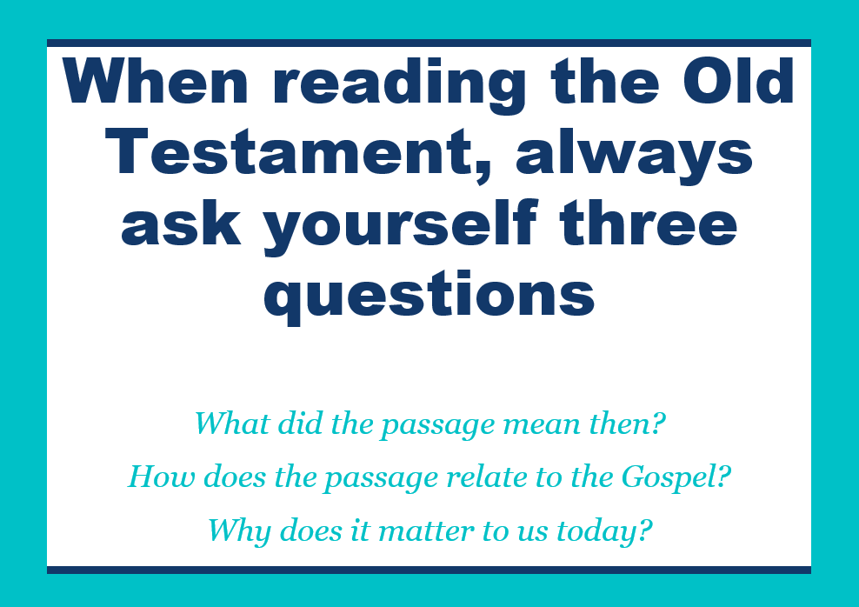
Ask:
• What does the passage mean?
  What words are repeated?
  What images are used?
  What’s the big idea?
• How does the passage relate to the Gospel?
  What biblical themes?
  Typological connections?
• Why is this passage important for us today?
  Similar sins?
  Similar solutions?

Slide 7
Typology?
A type is a prophetic picture of Christ’s person and work. It is a real person, place, object, or event which God ordained to act as a predictive pattern or resemblance of Christ’s person and work.
David Murray
A type has four main characteristics:
  The person, event, object, etc., is true, real, and/or factual.
  Other texts identify it as a type.
  The same truth is found in both the type and the antitype (the fulfillment of the type).
  The same truth is heightened and clarified in the antitype.

Slide 8

Homework
Read Leviticus 26
Re-read Zephaniah
Write out a tweet-sized summary of Zephaniah 2:1-3:8

Slide 9

Questions or comments?

