Slide 1

Zooming through Zephaniah
How to read the Prophets

Slide 2

Homework review
Read Leviticus 26
Re-read Zephaniah
Write out a tweet-sized summary of Zephaniah 2:1-3:8

Slide 3
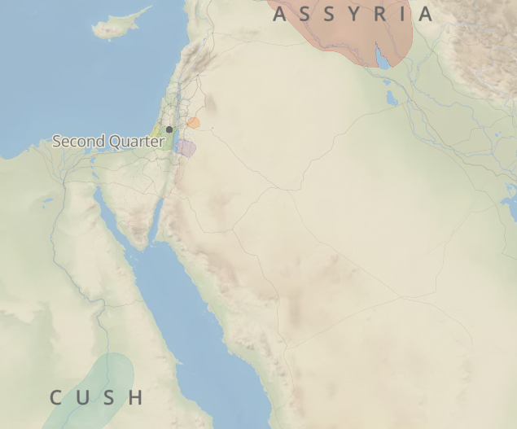
The prophets are lawyers!
The prophets are unoriginal: they base their message on God’s covenantal blessings and curses.
God announces the enforcement of His covenant through the prophets, so that His people would understand their experience.
They are creative in style, but not in content

Slide 4
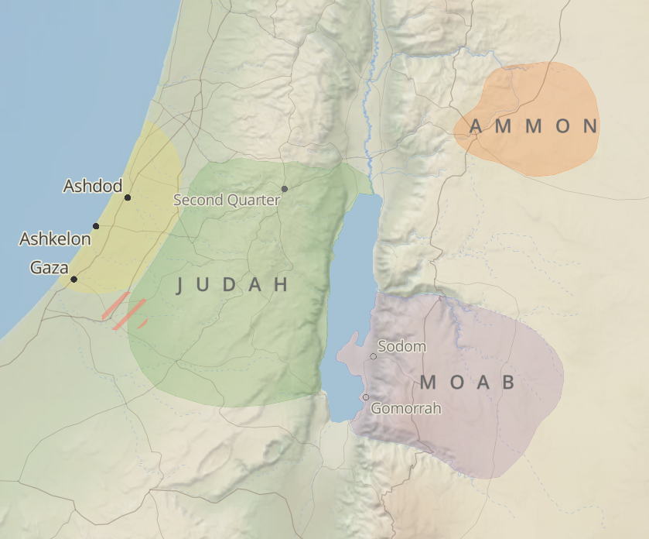
The nations around Zephaniah
Philistia (West)
Ammon & Moab (East)
Assyria (North)
Cush (South)

Slide 5
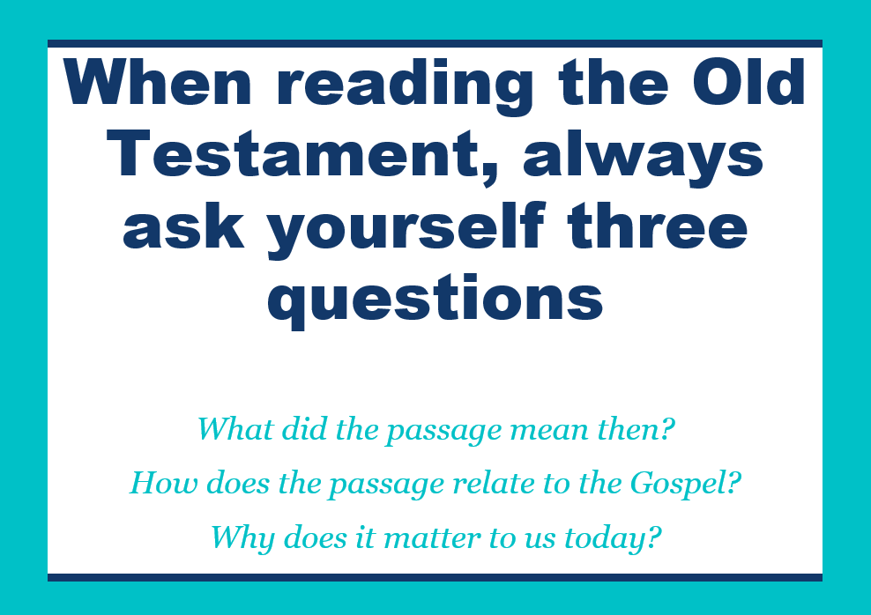
Read 2:1-3:8 and Ask:
• What does the passage mean?
  What words are repeated?
  What images are used?
  What’s the big idea?
• How does the passage relate to the Gospel?
  What biblical themes?
  Typological connections?
• Why is this passage important for us today?
  Similar sins?
  Similar solutions?

Slide 6

Homework
What are Israel’s sins?
Identify all the commands in Zephaniah(including 1:7!) What does God want Israel to do?

Slide 7

Questions or comments?

