Slide 1

Zooming through Zephaniah
How to read the Prophets

Slide 2

Homework review
What are Israel’s sins?
Identify all the commands in Zephaniah. What does God want Israel to do?

Slide 3

Tip#3! The prophets speak telescopically

Slide 4
Fulfillment of prophecy
“Some of the prophecies of the near future were set against the background of the eschatological future, and sometimes they seem to blend…the reason for this is that the Bible regularly sees God’s acts in temporal history in light of his overall plan for all of human history.”
Gordon Fee & Douglas Stuart, How to Read the Bible for all its Worth

Slide 5
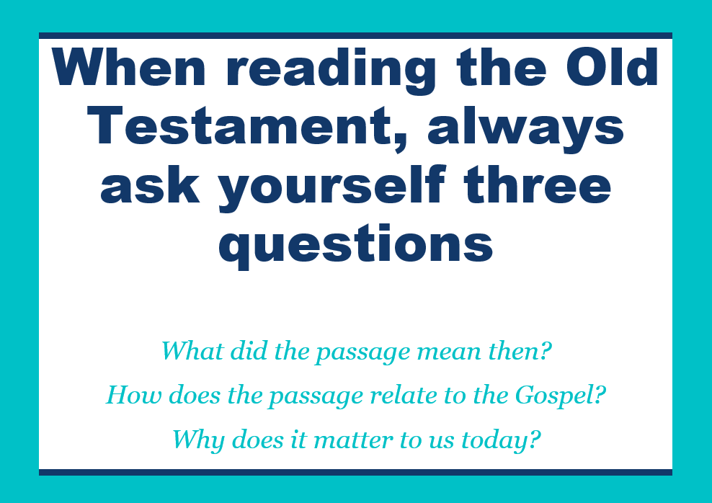
Read 3:9-20 and Ask:
• What does the passage mean?
  What words are repeated?
  What images are used?
  What’s the big idea?
• How does the passage relate to the Gospel?
  What biblical themes?
  Typological connections?
• Why is this passage important for us today?
  Similar sins?
  Similar solutions?

Slide 6
Typology?
A type is a prophetic picture of Christ’s person and work. It is a real person, place, object, or event which God ordained to act as a predictive pattern or resemblance of Christ’s person and work.
David Murray
A type has four main characteristics:
  The person, event, object, etc., is true, real, and/or factual.
  Other texts identify it as a type.
  The same truth is found in both the type and the antitype (the fulfillment of the type).
  The same truth is heightened and clarified in the antitype.

Slide 7

Homework
Believe the contents and obey the commands of Zephaniah
Select a memory verse

Slide 8

Questions or comments?

